Slide 1

VISUALIZATION OF SENSOR DATA IN IOT
Instructer: Roman Tankelevich
Aashwiyuja Naidu Palla
Laxmi Bhargavi Pabbu

Slide 2

Table of contents
01
05
08
04
Abstract
Methodology
06
Implementation
02
User of Sensor Data
07
Proposed Visulalization
03
Sensor Data Management
Problem & Solution
Intro to Aws Services

Slide 3

Abstract
Iot(Internet of Things)
A network of interconnected things
Contains many possibilities worth investigating
Essential Features of IOT
Visualization of Data

Slide 4

Uses of Sensor Data
Sensor Data
Thermometers, Pressure gauges, Pollution Detectors, Cameras, Microphones, Glucose Sensor, and ECGS
Uses of Sensor Data
Monitoring of cities, Protected species, Air quality, Predicting Natural Calamities, Predicting on coming incidents.

Slide 5
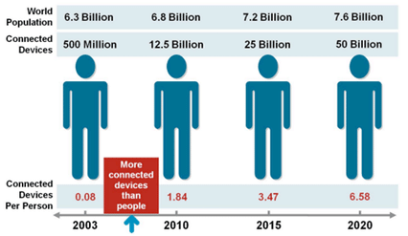
SENSOR DATA MANAGEMENT
It's not easy to deal with a large number of databases that are often irregular and unstructured.
Amazon dynamo database (for storing values)
Amazon s3 – amazon simple storage service

Slide 6
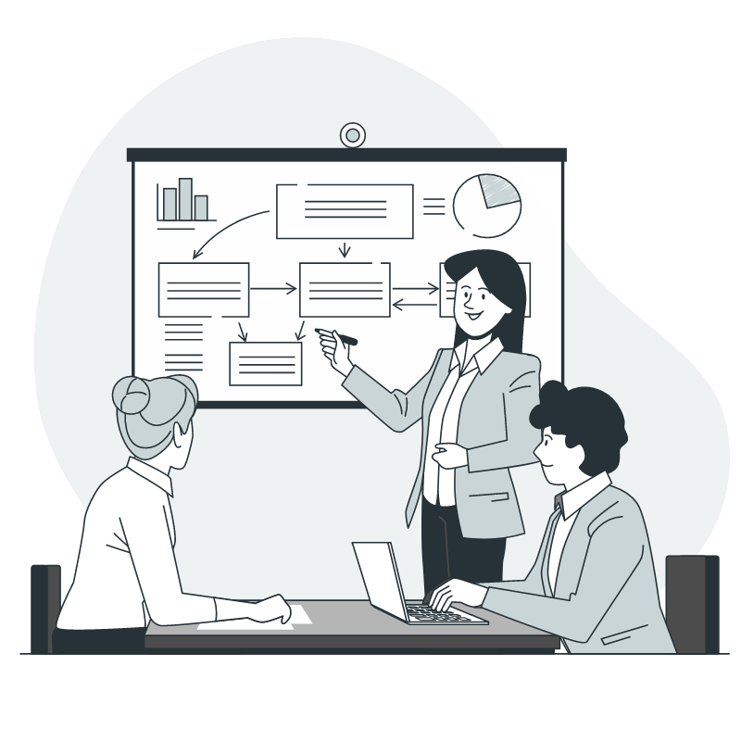
01
Introduction To Aws Services

Slide 7

AWS
Iot
AKF
AKA
AQS
Amazon Kinesis Firehose
Amazon Kinesis Analytics
Amazon QuickSight

Slide 8
Methodology
Presentation Layer: Display the KPIs and reflect the results of user queries
AWS
(Device)
Different Sensor
(Control)
Processing Layer: Analyze the data acquired from the data layer and prepare for the visualization
See
Data
User Interface
User
Transform
Control
Data layer: Aggregate data from different sources

Slide 9
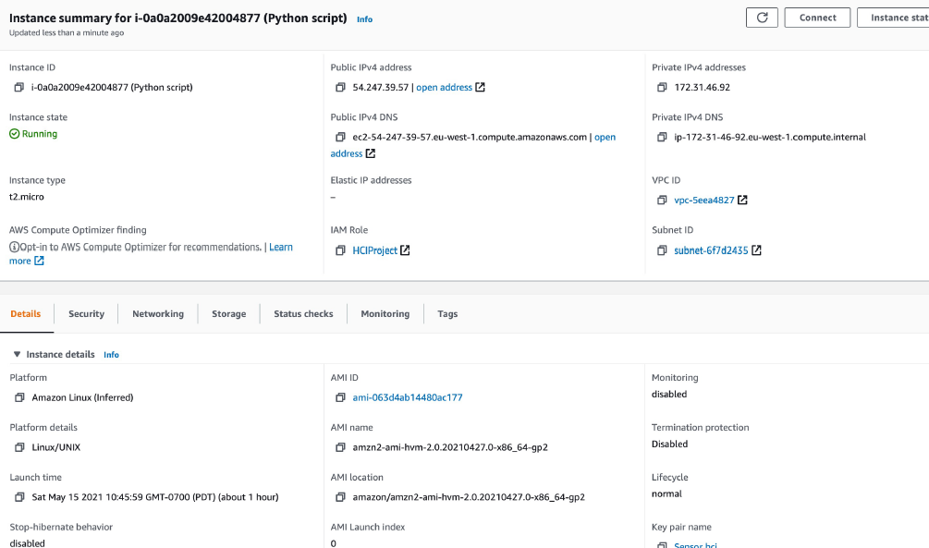
Implementation
Step 1 : collect sensor data
Setting up AWSIOT
The script requires access to AWS CLI credentials and BOTO3 to be on the machine running the script
Create ec2 instance
Collect sensor data

Slide 10
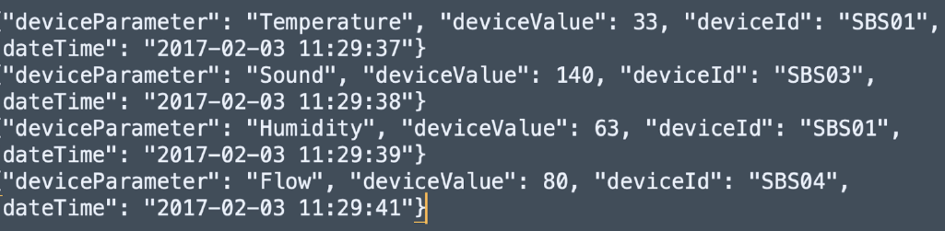
Implementation
Step 2: Collect sensor data
Random sensor data is collected which was generated using a python script

Slide 11
Step 3: Create Firehose Delivery Streams
Firehose Delivery System
Source
Destination
Source Records
Processed Records
WE CREATED 3 FIREHOSE DELIVERY SYSTEM

Slide 12

STEP 4: SET UP AWS IOT TO RECEIVE AND FORWARD INCOMING DATA
Name | Iot_to_Firehose
Attribute | *
Topic Filter | /sbs/devicedata/#
Condition | <none – leave blanks>
Add Action | Send message to an Amazon Kinesis stream (select Iot-Source-Stream from the Stream name dropdown)
Select Separator | “\n (newline)”

Slide 13
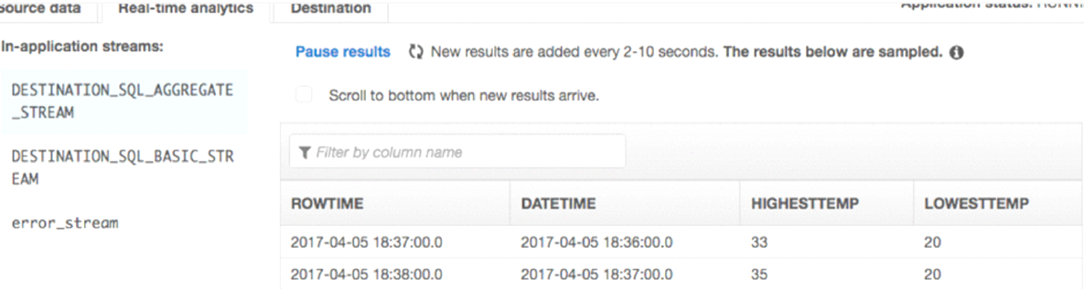
STEP 5 : ANALYTICS APPLICATION TO PROCESS SENSOR DATA
STEP 6 : CONNECT THE ANALYTICS APPLICATION TO OUTPUT FIREHOSE DELIVERY STREAMS
A single analytics application can have multiple destinations
Amazon CLI
Create new application on AWS to process the incoming data
Device parameters
Device values
Device id and timestamp
In-built SQL Editor

Slide 14
PROPOSED STEP FOR VISUALIZATION ON AMAZON QUICKSIGHT
Buying Method
Temperature
Flow
Temperature
Sound
Temperature
Sound
Humidity
30%
SBS001
SBS003
SBS013

Slide 15
USER INTERFACE (WHERE THE USER CAN CONTROL WITH DEVICES)
Dialogue
A new dialogue session?
NLG:
Language generation
Text-to-speech
SUI:
Speech input
Speech recognition
DM:
State tracking
Action execution
Representative output
NLU:
Utterance analysis
Intent identification

Slide 16
Proposed Problems And Solutions
How to increase the communication between dashboards and users ?
How to improve data completeness ?
Voice-based virtual assistant integrated into the smartphone app
Dashboard design
Virtual assistant

Slide 17
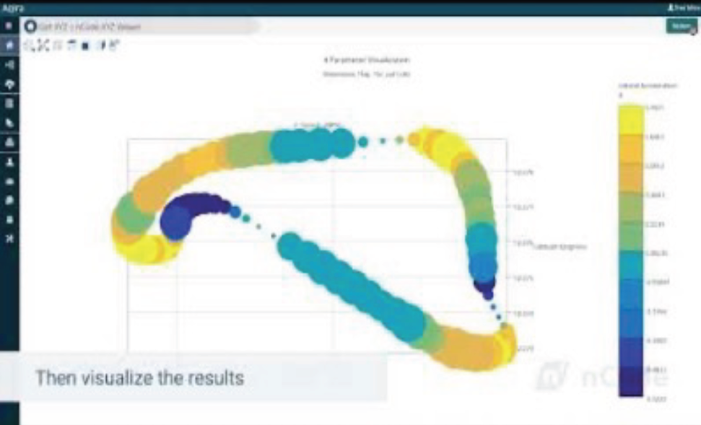
Example of the GUI

Slide 18

Conclusion
The goal was to visualize the sensor data
Useful interpretation to the sensor data
Improve the quality of lifestyle

Slide 19

Thank You

